Slide 1
Operations Research 5 AMAOR5-B Programming Assignment Executive Summary Year 2024-2025 Term 1 Instructor Roy Willemen

Slide 2
Context
Company: Paint Shop
Objective: Schedule painting orders on machines (M1, M2,..) efficiently to minimize late delivery penalty charges.
Data: Orders with details, Machines with processing speed, Set up times when switching from one colour to another
Constraints: No two orders can be painted on the same machine simultaneously, Machine cannot paint during setup

Slide 3
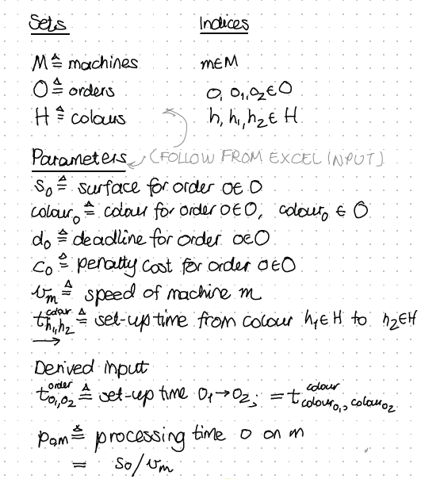
Mathematical Model and Example Data
(Full math model can be found on Canvas)

Slide 4
Deliverables
Python code files (.py)
PDF document with rationale, pseudocode, tests, and experimental results
Excel file with best high-quality schedule for November 2024

Slide 5
Example Schedule (Output)

Slide 6
Technical Requirements
Python script imports and exports data correctly.
Minimize hard-coded data for flexibility.
Repeatability: Paint Shop seeks a reusable solution method for future scheduling instances.

Slide 7
Other Requirements
Research on three solution methods required:
Constructive heuristic to create a feasible schedule
Simple first/best improvement heuristic for schedule improvement
Complex meta-heuristic (e.g., Tabu Search, Simulated Annealing) for robust high-quality schedules
Decision on solution method based on experimental results
Structured and well-documented PDF document

Slide 8
Assessment
Based on Assessment Form
Typically, a single grade for both partners, but individual grading possible in case of significant disparities in effort or knowledge.

Slide 9
Timing
September 2024 data available per 5 September ‘24
November 2023 data available by Mon 7th Oct. ‘24
Hand in working version of justification by Mon 7th Oct. ‘24
Submission Deadline: Mon 13th Nov. 2023, 6 pm

Slide 10
Communication
Questions via Discussion section in Canvas
Updates on Programming Assignment through Announcements.

